Slide 1
Nerves, Hormones and Homeostasis
Biology SL
Ms. Ragsdale

Slide 2
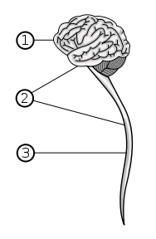
Human Nervous System
Central Nervous System (CNS) – the control center of your brain
Receives all the impulses from your body and coordinates activity
Consists of the brain and spinal cord
Peripheral Nerves
Sensory and Motor System
Neurons – specialized cells that carry rapid electrical impulses

Slide 3
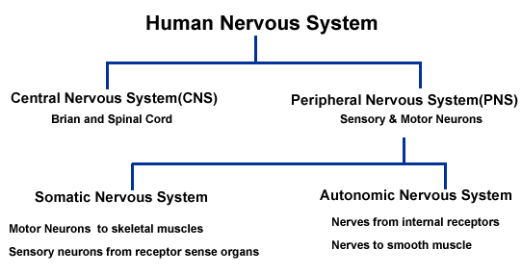

Slide 4
Neurons
Specialized cells that transmit information throughout the body very rapidly
3 Basic Parts of a Neuron
Dendrites – branched part of a neuron that are designed to create more surface area
Used for connecting to other neurons or detect things about the environment
Cell Body – Main body of the cell containing the nucleus, mitochondria, ribosomes and other organelles
Axon – a long cable-like projection that carries the nerve impulses (action potential) away from the cell body
Can be covered by a myelin sheath which is a protective layer of insulating fat

Slide 5
Neurons
Schwann cell – companion cells that wrap themselves around the axon many times over
What the myelin sheath is made up out of
Node of Ranvier – the gaps between myelin sheathes that help the impulse speed up
By interrupting the insulation at intervals, it allows the impulse to “jump” from node to node
Axon terminal – the place where one axon ends and forms a synapse with another neuron

Slide 6
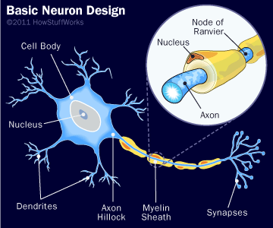

Slide 7
Draw and Label a diagram of a motor neuron
Nerve impulse can be passed from the axon of one neuron to the dendron of another at a synapse.
A nerve is a discrete bundle of several thousand neuron axons

Slide 8
3 Types of Neurons
Sensory Neurons
Have long axons and transmit nerve impulses from sensory receptors all over the body to the CNS
Motor Neurons
Motor neurons also have long axons and transmit nerve impulses from the central nervous system to effectors (muscles and glands) all over the body
Interneurones (Connector or Relay neurons)
Much smaller cells connect various neurons within the brain and spinal cord

Slide 9
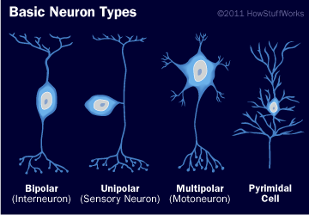
3 Types of Neurons

Slide 10
How Do Nerve Impulses Work?
Step I
Sensory Neurons are located around the body – skin, eyes, nose, tongue – that collect stimuli from Receptors
The stimuli are converted into energy in the form of a small impulse
The impulse is sent from the sensory nerves to the CNS using sensory neurons

Slide 11
How Do Nerve Impulses Work?
Part II
The sensory neurons bring the impulse (message) to the relay neurons inside the CNS (brain and spinal cord)
The relay neurons move the message inside the brain and bring it to the correct spot
The CNS now sends out an impulse (message) to the motor neurons

Slide 12
How Do Nerve Impulses Work?
The motor neurons take the relayed message (impulse) to the effectors
Effectors are often muscles
Once the message is relayed, a response is produced

Slide 13
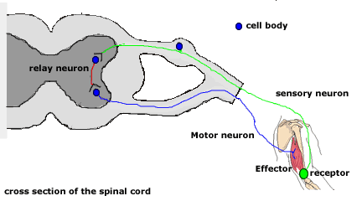
Nerve Impulse Pathway
Cross section of the vertebrae in the spinal column

Slide 14
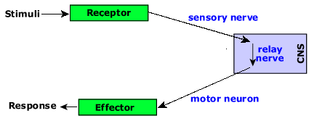
Nerve Impulse Pathway

Slide 15
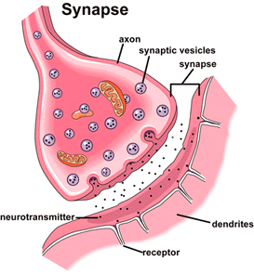
Synapses
Synapse – a junction between two neurons
Synaptic cleft – the plasma membranes of the neurons are separated by this narrow fluid-filled gap
Neurotransmitters – messages that are passed across the synapse in the form of chemicals

Slide 16
How Synapses Work
The nerve impulse reaches the axon terminal (end of the pre-synaptic neuron)
Depolarization of the pre-synaptic membrane causes voltage gated calcium channels to open. Calcium ions diffuse into the pre-synaptic neuron.
Influx of calcium causes vesicles of the neurotransmitter to move to the pre-synaptic membrane and fuse with it, releasing the neurotransmitter into the synaptic cleft by exocytosis.

Slide 17
Synapses (continued)
The neurotransmitter diffuses across the synaptic cleft and binds to the receptors in the post synaptic membrane.
The receptors are transmitter-gated ion channels which open when the neurotransmitter binds. Sodium and other positively charged ions diffuse into the post-synaptic membrane.
Depolarization passes on down the post-synaptic neuron as an action potential.
Neurotransmitter in the synaptic cleft is rapidly broken down to prevent continuous synaptic transmission. Calcium ions are pumped out of the pre-synaptic neuron into the synaptic cleft.

Slide 18
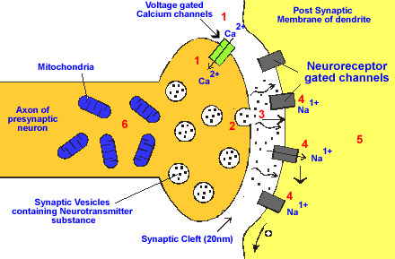
Calcium ions diffuse in though channels
Neurotransmitter vesicles move to the membrane
Neurotransmitter diffuses across the synaptic cleft
Sodium Ions enter the post synaptic neuron and cause depolarization
Nerve impulse setting off along the post synaptic neuron
Calcium is pumped out and neurotransmitter is broken down.

Slide 19
Electrical Activity Terms
Resting Potential - the negative charge registered when the nerve is at rest and not conducting a nerve impulse
Action Potential - the positive electrochemical charge generated at the nerve impulse.
Depolarization - a change from the negative resting potential to the positive action potential
The potential across a membrane is reversed
Repolarization - the change in the electrical potential from the positive action potential back to the negative resting potential
The potential across a membrane is restored

Slide 20
Concentration Gradients
Nerve at rest (Polarized) – more potassium ions than sodium ions inside the cell
Sodium ions are kept at a high concentration outside the cell using an ATP pump
Negative charge inside the cell
Positive charge outside the cell
Nerve active (Depolarized) – sodium ions flood into the cell
The inside is now positive – higher sodium content
The outside is now negative – higher potassium content
Once the impulse has left (Repolarization) – sodium ions leave the cell
Charges return to normal

Slide 21
http://www.youtube.com/watch?v=7EyhsOewnH4&feature=related

Slide 22
Passage of the Nerve Impulse
An action potential in one part of a neuron causes an action potential to develop in the next section of a neuron
This develops because of diffusion of the sodium ions between the region with an action potential and the region at the resting potential.
When the local current makes the potential rise above the threshold level, voltage gated channels open

Slide 23
Passage of the Nerve Impulse
Sodium channels open very quickly causing sodium to diffuse into the neuron down the concentration gradient.
Causes a reduction in the membrane potential and more channels begin to open.
The inside is now positive while the outside is negative – depolarization
After a short delay, potassium channels open allowing potassium to diffuse down the concentration gradient and back into the cell.

Slide 24
