Slide 1
Nerves, Hormones and Homeostasis
Biology SL
Ms. Ragsdale

Slide 2
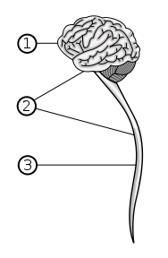
Human Nervous System
Central Nervous System (CNS) – the control center of your brain
Receives all the impulses from your body and coordinates activity
Consists of the brain and spinal cord
Peripheral Nerves
Sensory and Motor System
Neurons – specialized cells that carry rapid electrical impulses

Slide 3
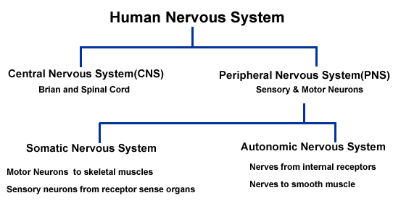

Slide 4
Neurons
Specialized cells that transmit information throughout the body very rapidly
3 Basic Parts of a Neuron
Dendrites – branched part of a neuron that are designed to create more surface area
Used for connecting to other neurons or detect things about the environment
Cell Body – Main body of the cell containing the nucleus, mitochondria, ribosomes and other organelles
Axon – a long cable-like projection that carries the nerve impulses (action potential) away from the cell body
Can be covered by a myelin sheath which is a protective layer of insulating fat

Slide 5
Neurons
Schwann cell – companion cells that wrap themselves around the axon many times over
What the myelin sheath is made up out of
Node of Ranvier – the gaps between myelin sheathes that help the impulse speed up
By interrupting the insulation at intervals, it allows the impulse to “jump” from node to node
Axon terminal – the place where one axon ends and forms a synapse with another neuron

Slide 6
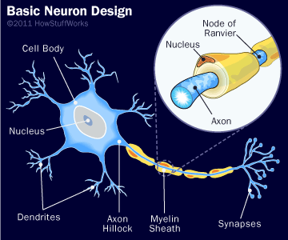

Slide 7
Draw and Label a diagram of a motor neuron
Nerve impulse can be passed from the axon of one neuron to the dendron of another at a synapse.
A nerve is a discrete bundle of several thousand neuron axons

Slide 8
3 Types of Neurons
Sensory Neurons
Have long axons and transmit nerve impulses from sensory receptors all over the body to the CNS
Motor Neurons
Motor neurons also have long axons and transmit nerve impulses from the central nervous system to effectors (muscles and glands) all over the body
Interneurones (Connector or Relay neurons)
Much smaller cells connect various neurons within the brain and spinal cord

Slide 9
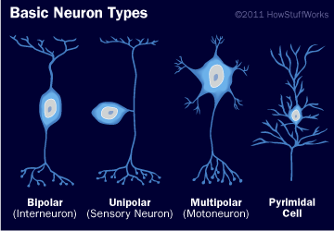
3 Types of Neurons

Slide 10
How Do Nerve Impulses Work?
Step I
Sensory Neurons are located around the body – skin, eyes, nose, tongue – that collect stimuli from Receptors
The stimuli are converted into energy in the form of a small impulse
The impulse is sent from the sensory nerves to the CNS using sensory neurons

Slide 11
How Do Nerve Impulses Work?
Part II
The sensory neurons bring the impulse (message) to the relay neurons inside the CNS (brain and spinal cord)
The relay neurons move the message inside the brain and bring it to the correct spot
The CNS now sends out an impulse (message) to the motor neurons

Slide 12
How Do Nerve Impulses Work?
The motor neurons take the relayed message (impulse) to the effectors
Effectors are often muscles
Once the message is relayed, a response is produced

Slide 13
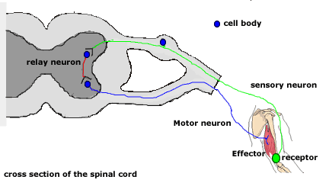
Nerve Impulse Pathway
Cross section of the vertebrae in the spinal column

Slide 14
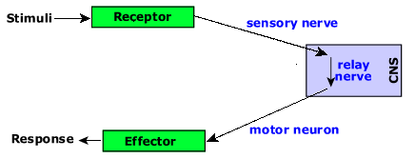
Nerve Impulse Pathway

Slide 15
Synapses
Synapse – a junction between two neurons
Synaptic cleft – the plasma membranes

Slide 17
Electrical Activity Terms
Resting Potential - the negative charge registered when the nerve is at rest and not conducting a nerve impulse
Action Potential - the positive electrochemical charge generated at the nerve impulse.
Depolarization - a change from the negative resting potential to the positive action potential
Repolarization - the change in the electrical potential from the positive action potential back to the negative resting potential

