Slide 1
Chapter 11: Meiosis and Genetic Mutation

Slide 2
Meosis
Occurs in the gametes of organisms
Egg, sperm, pollen, ovules
Two stage process
Meiosis I – homologous pairs are separated
Meiosis II – sister chromatids are separated

Slide 3
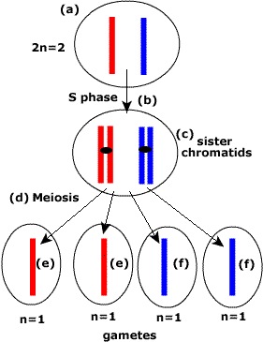
Reduction
Meiosis is a reduction division of a diploid nucleus(2n) to form a haploid nucleus (n)
Every cell in your body exists as 2n EXCEPT for your gametes (n)

Slide 4
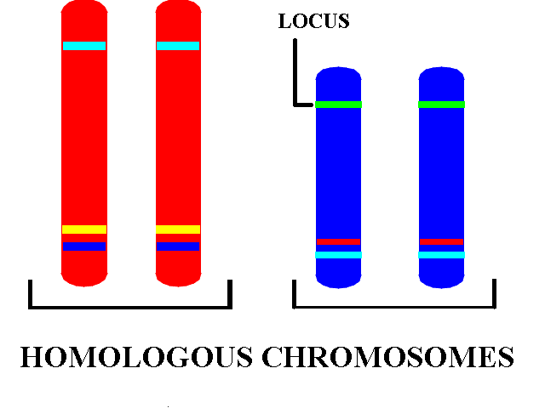
What the heck is a homologous chromosome??
Pairs of a chromosomes with the same basic length, centromere position and gene loci
In other words, they might code for the same gene but not necessarily the same allele
One codes for blue eyes, one for green

Slide 5
Homologous chromosomes
Diploid Still Diploid, but copied

Slide 6
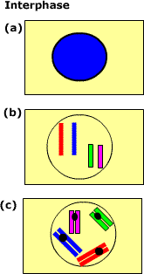
Interphase
Basically, identical to regular interphase
Consists of G1, S, G2
During G2 (figure b) we are at 2N = 4
At S1DNA replicates like normal into homologous pairs

Slide 7
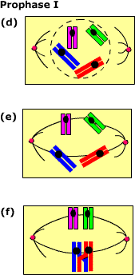
Prophase I
Nuclear membrane breaks down
Pairs of sister chromatids attach to the spindle microtubles at the centromere
DNA begins to condense

Slide 8
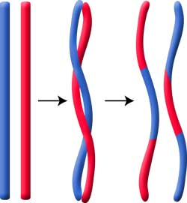
Crossing Over – Prophase I
Right after pairing up, homologous chromosomes overlap and exchange genetic information
Increases genetic variety
Bivalents – the two crossed over chromosomes
Tetrad – when all four chromosomes are involved
Chiasmata – the “X” shape that forms when bivalents cross together

Slide 9
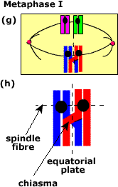
Metaphase I
Homologous pairs line up at the equator and prepare to separate
This is where crossing over is easily noticed
Crossing Over – the exchange of genetic material between non-sister chromatids
Actually occurs during Prophase I

Slide 10
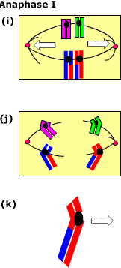
Anaphase I
Spindle microtubles contract and pull the pairs apart
Homologous pairs are separated into individual chromosomes

Slide 11
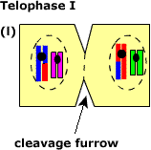
Telophase I
Chromosomes now exists as two separate sets
Each set contains one complete set of the homologous pairs

Slide 12
Meosis II
Looks very similar to mitosis
Sister chromatids now separate into individual strands

Slide 13
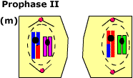
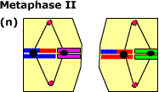
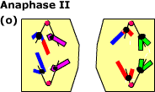
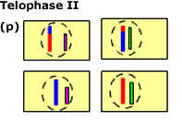
Prophase II – spindles reform
Metaphase II – sister chromatids line up
Anaphase II – chromatids separate
Telophase II – four new cells now exist

Slide 14
Significance of Sex Cells being 1n
All other body cells are 2n, right?
Mom gives 1n
Dad gives 1n
1n + 1n = 2n

Slide 15
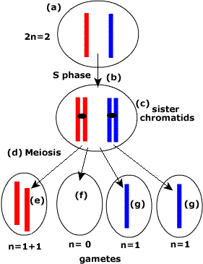
Non-Disjunction – Meiosis gone wrong
Sometimes, the chromosomes don’t separate quite like they are supposed to => non-disjunction
Can lead to genetic disorders

Slide 16
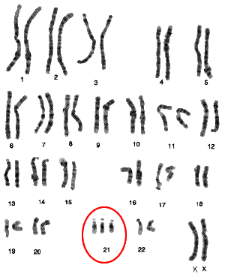
Down’s Syndrome
Trisomy 21
Chromosome 21 did not separate correctly (nondisjunction) so instead of 2, there are 3 chromosomes

Slide 17
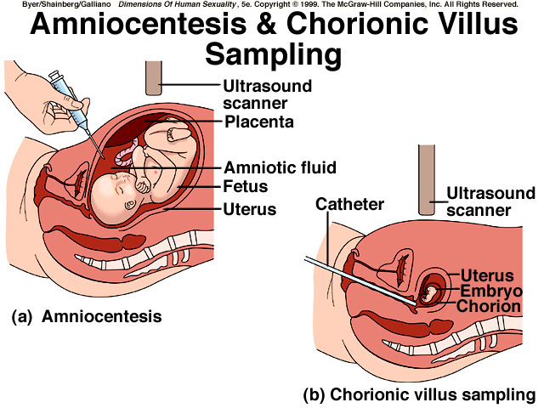
Genetic Testing – In Utero
Amniocentesis – Involves placing a needle through the mother’s abdominal wall using ultrasound to guide the needle. Removes a small amount of amniotic fluid for testing purposes.
Chorionic villus sampling (CVS.. Not the store) – placental cells are samples, specifically the chorion.

