Slide 1
Genetic Engineering and Biotechnology
Mrs. Ragsdale
Biology I

Slide 2
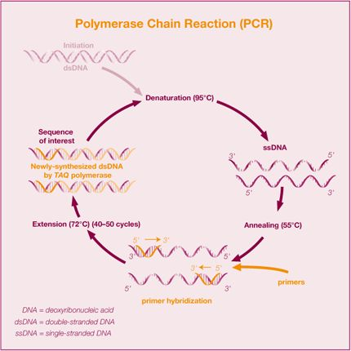
Polymerase Chain Reaction (PCR)
Using a series of heating/cooling techniques in order to clone many copies of a particular strand of DNA

Slide 3
PCR
Thousands of useful copies of DNA made within 20 cycles

Slide 4
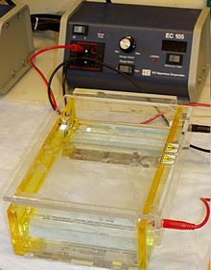
Gel Electrophoreisis
DNA can be chopped into pieces of various sizes and put into a gel matrix
The DNA is filtered out based on the size of the various pieces
Larger pieces are closer to the start

Slide 5
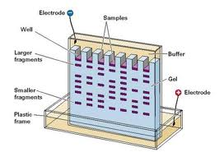
Banding and DNA Profiling
Satellite (Tandem repeating) DNA are highly repetitive sequences of DNA from the non coding region of DNA
Different individuals have a unique length to their satellite regions.
DNA “fingerprinting”

Slide 6
Paternity
DNA patterns come from the Mom and Dad
The bands on the child's fragments are either found on the mother or the male1.
Male 1 therefore is this father of this child.
None of the Male 2 bands appear in the child

Slide 7
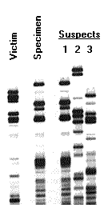
Forensics
Note that the bands on the specimen are matched by the bands on the Suspect 1.
This means that Suspect 1 was present at the crime scene.
The law will still require to prove a crime was committed and then that Suspect 1 committed the crime

Slide 8
The Human Genome Project
Identify all the approximate 30,000 genes in human DNA.
Determine the sequences of the 3 billion chemical base pairs that make up human DNA.
Transfer related technologies to the private sector.
To help achieve these goals, researchers also are studying the genetic makeup of several nonhuman organisms. These include the common human gut bacterium Escherichia coli, the fruit fly, and the laboratory mouse.
http://www.sanger.ac.uk/about/history/hgp/

Slide 9
Gene Transfer
All living organisms share the same basic genetic code
This allows us the ability to transfer genes between organisms because the basic amino acid sequence of polypeptides translated from them is essentially unchanged

Slide 10
Basic Gene Transfer techniques
Restriction enzymes are used to cut out the useful gene that is to be transferred.

Slide 11
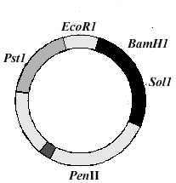
Stage 2: Plasmids
Plasmids are small circular DNA molecules found in bacteria.
These can be cut with the same restriction enzyme as above.
This leaves the same complementary 'sticky ends' in the plasmid
The plasmid can be cut at particular sites. These are called restriction sites and some are named in the diagram

Slide 12
Stage 3: Recombination
DNA ligase seals up the plasmid.
The plasmid with the modified gene is inserted into a recombinant plasmid.
The recombinant plasmid are mixed with a strain of E.Coli bacteria or other host cell
The host cell begins making the proteins that you have added via recombination

Slide 13
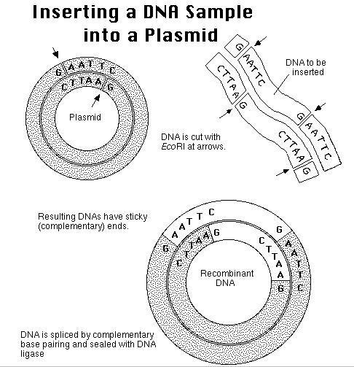

Slide 14
Examples of GMO’s used today
GMO = genetically modified organism
Golden rice is a genetically modified rice crop that produces beta-carotene, which can be metabolized into Vitamin A within the body. Scientists hope that golden rice will eventually be a cheap source of beta-carotene in malnourished countries, reducing the number of children worldwide that go blind from Vitamin A deficiency

Slide 15
GMO Examples
Bt maize is a genetically modified corn crop that produces a toxin that kills European corn borers feeding on the maize.
Factor IX : A human clotting factor is produced by genetically modified sheep. The protein (factor IX) is expressed in milk from which it must be isolated before use by hemophiliacs.

Slide 16
GMO Examples
Tomato salt tolerance:
Plants find it hard to grow in salty conditions since this hypertonic soil water results in desiccation, wilting and death of the plant. Tomato plants have now been genetically modified to carry the gene for salt tolerance. The origin of the gene was a weed called Arabidopsis thaliana. The transgenic tomato plant can tolerate plants. This now provides the opportunity for a crop to be grown in an otherwise sterile soil.

Slide 17
GMO Benefits
Increased yields particularly in regions of food shortage.
Yields of crops with specific dietary requirement such as vitamins and minerals.
Crops that do not spoil so easily during storage.
GM animals produce similar effect including higher meat yields.

Slide 18
GMO Disadvantages
The foods (animal and plant) are considered un-natural and unsafe for human consumption.
There is a risk of the escape of 'genes' into the environment where they may be passed to other organisms with unknown effects.

Slide 19
Steps for Cloning
The nucleus is removed from the egg cell.
The egg cell without a nucleus is fused with the udder cell using a pulse of electricity.
The fused cells develop into zygotes.
Inserted back into mother

Slide 20
