Slide 1
Chapter 3: Cell Division
Mrs. Ragsdale
Biology SL

Slide 2
Interphase is an active period in the life of a cell when many metabolic reactions occur, including protein synthesis, DNA replication and an increase in the number of mitochondria and/or chloroplasts

Slide 3
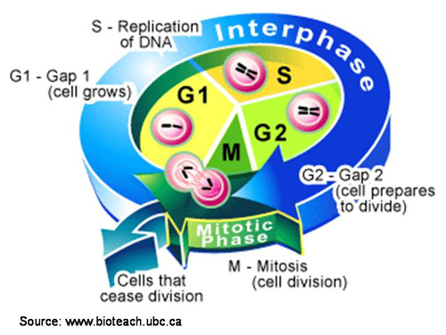
THE THREE PARTS OF INTERPHASE
G1 – CELL GROWS AND FUNCTIONS NORMALLY (PROTEIN SYNTHESIS / MITOCHONDRIA REPLICATION ETC.)
S – DNA IS COPIED. At this point the mass of DNA in the cell has doubled.
G2 – CELL CHECKS ITSELF AND PREPARES TO ENTER MITOSIS

Slide 4
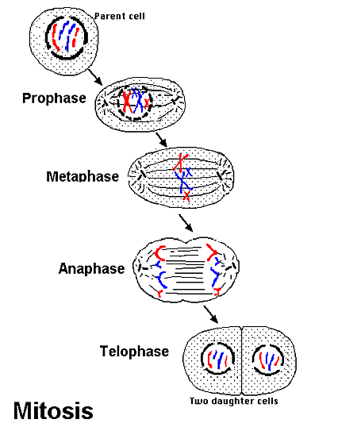
MITOSIS
IT’S IMPORTANT TO UNDERSTAND WHAT MITOSIS IS AND WHAT MITOSIS ISN’T
MITOSIS IS THE DIVISION OF THE NUCLEUS THAT GENERATES TWO DAUGHTER NUCLEI
MITOSIS IS NOT THE DIVISION OF THE CELL ITSELF, ONLY THE NUCLEUS

Slide 5
4 PHASES OF MITOSIS
PROPHASE
METAPHASE
ANAPHASE
TELOPHASE

Slide 6
1. PROPHASE
DNA CONDENSES TO FORM CHROMOSOMES
NUCLEUS AND NUCLEAR MEMBRANE BREAK DOWN
CENTRIOLES BEGIN TO SEPARATE TO OPPOSITE ENDS OF THE CELL
THE MITOCHONDRIAL SPINDLE BEGINS TO DEVELOP

Slide 7
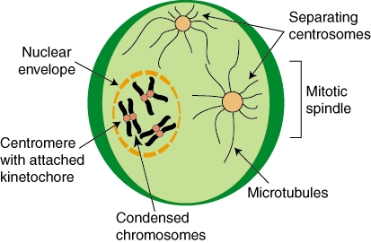
PROPHASE
Centrioles - the main microtubule organizing center
Mitotic Spindle microtubules – cytoskeleton that pulls apart chromosomes

Slide 8
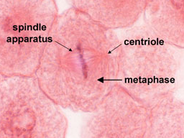
2. METAPHASE
CHROMOSOMES LINE UP ACROSS THE CENTER OF THE CELL
SPINDLE MICROTUBLES – LINE UP THE CHROMOSOMES
ATTACH TO CENTROMERE

Slide 9
3. ANAPHASE
BEGINS WHEN CHROMOSOMES SEPARATE
THE CENTROMERE SPLITS (THE THING THAT HELD THE CHROMOSOMES TOGETHER)
SISTER SINGLE STRANDED CHROMOSOMES MOVE TO OPPOSITE POLES

Slide 10
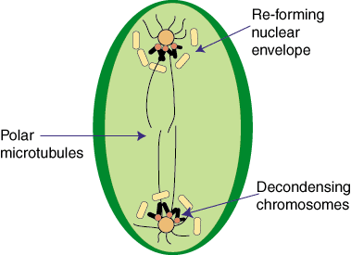
4. TELOPHASE
MITOTIC SPINDLE APARATUS DISAPPEARS
TWO NEW NUCLEAR MEMBRANES DEVELOP
CHROMOSOMES RELAX BACK TO CHROMATIN

Slide 11
END OF MITOSIS
RESULTS IN TWO GENETICALLY IDENTICAL NUCLEI
NOW THAT MITOSIS IS OVER…….
Cytokinesis - process whereby the cytoplasm of a single cell is divided to spawn two daughter cells
Begins during Telophase
In animals – cell membrane pinches in
In plants – cell plate forms – vesicles join to form new cell membrane

Slide 12
Purposes of Mitosis
Growth: multicellular organisms increase their size
This growth involves increasing the number of cells through mitosis. These cells will differentiate and specialize their function.
Embryonic Development
Tissue Repair: As tissues are damaged they can recover through replacing damaged or dead cells.
Asexual Reproduction: the production of offspring from a single parent using mitosis.
offspring are genetically identical to each other and to their “parent”

Slide 13
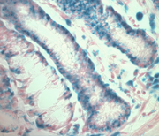
Uncontrolled Cell Growth
Cancer cells do not respond to the signals that regulate the growth of most cells.
Tumor – group of cells that divide out of control
**Tumors can form in ANY tissue!
Cancer – when the cells dividing out of control spreads to surrounding tissue.

Slide 14
'Tumors are not foreign invaders. They arise from the same material used by the body to construct its own tissues. Tumors use the same components -human cells- to form the jumbled masses that disrupt biological order and function and, if left unchecked, to bring the whole complex, life sustaining edifice that is the human body crashing down'.
R. Weinberg, R. (1998) One Renegade Cell. London:Phoenix, Science Masters Series.

Slide 15
DNA BASICS
DNA is the molecule used for hereditary information
(sometimes RNA)
DNA structure:
Double stranded helix

Slide 16
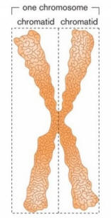
CHROMOSOMES – very compact structure DNA forms before reproduction
Before a cells starts forming chromosomes, the cell makes a copy of all it’s DNA
Each double stranded Chromosome has 2 copies of the same genes
CHROMATID – one set of the copied DNA. Each chromatid consists of one long strand of DNA

Slide 17
PARTS OF A CHROMOSOME:
Chromatid – half of the double stranded chromosome
Centromere – point where the two chromatids are held together until pulled apart in cell division.

Slide 18
HOW IS DNA ORGANIZED?
DNA IS EXTREMELY LONG FOR ITS SIZE!
IMAGINE A ROPE THE SIZE OF A FOOTBALL FIELD. NOW TRY TO GET THAT ROPE COILED UP TIGHTLY INTO A SMALL HANDBAG.
IT WOULD TANGLE UP REALLY EASILY, RIGHT?
DNA MUST FIND A WAY TO KEEP FROM GETTING TANGLED UP

Slide 19
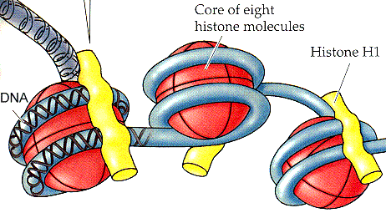
HISTONES
HISTONES ARE BIG PROTEINS THAT DNA WRAPS AROUND
ACTS LIKE A SPOOL OF THREAD
KEEPS THE DNA FROM TANGLING

Slide 20
NUCLEOSOMES AND CHROMATIN
NUCLEOSOMES – THE INDIVIDUAL “UNITS” OF DNA WRAPPED AROUND A HISTONE
THEY COIL UP TIGHTLY AROUND EACH OTHER FORMING A THICK FIBER
CHROMATIN – THE THICK FIBER FORMED BY DNA WRAPPED AROUND HISTONE PROTEINS

