Slide 1
Membranes
Mrs. Ragsdale
Bio SL

Slide 2
Parts of the Cell Membrane
Phospholipid Bilayer
Phospholipids arranged in a bilayer with polar, hydrophilic heads facing outwards and nonpolar tails fatty acid tails facing each other.
Hydrophobic layer acts as a barrier keeping everything out but the smallest molecules like oxygen and carbon dioxide

Slide 3
Parts of the Cell Membrane
Integral Proteins
Usually span from one side of the phospholipid bilayer to the other
Typically are involved with transporting substances across the membrane

Slide 4
Parts of the Cell Membrane
Peripheral Proteins
Sit on the surface of the cell membrane
Can move around very quickly when necessary
Remain on only once side of the cell membrane or the other
May also be enzymes that catalyze reactions in the cytoplasm

Slide 5
Parts of the Cell Membrane
Glycoproteins
Involved in cell recognition
Part of the immune system’s recognition system
Act as receptors in cell signaling
Cholesterol
Binds together lipid in the plasma in the plasma membrane reducing its fluidity and giving structural support

Slide 6
Other Protein Functions
Hormone binding sites
Immobilized enzymes – active sites located on the outside of the cell membrane
Cell adhesion – allows cells to form tight junctions and pack closely together in some types of tissue
Cell to cell communication

Slide 7
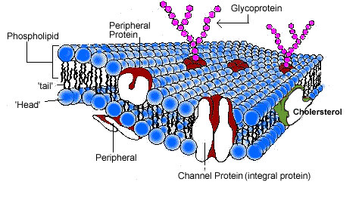
The Cell Membrane

Slide 8
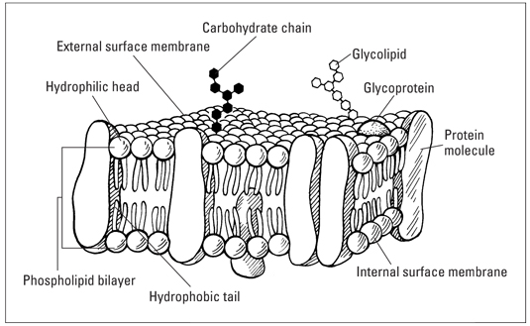
Let’s Draw It!

Slide 9
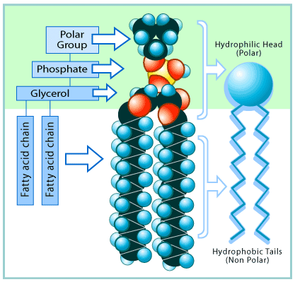
Phospholipid Breakdown
Hydrophilic ( Polar) Heads
Philic = water lover
Hydrophobic (Nonpolar) Tails
Phobic = water hater

Slide 10
Functions of Membrane Proteins
Channel Proteins
Create channels that span both sides of the membrane
Site of passive transport
Pump Proteins
Channels that span both sides of the membrane
Pumps release energy from ATP and use it to power active transport

Slide 11
Functions of Membrane Proteins
Receptor Proteins
Sites exposed on the outside of the membrane built to recognize one specific hormone
Involved in cell and substance recognition
Enzymes
Either catalyze reactions inside or outside the cell depending on the location of the active site

Slide 12
Functions of Membrane Proteins
Electron Carriers
Allow the passage of electrons from one carrier to the other

Slide 13
Transportation!
Two major categories
Active transport – requires some form of energy input (ATP)
Passive – requires no energy input
Diffusion
Facilitated Diffusion
Osmosis

Slide 14
Passive Transport
Simple Diffusion – movement of molecules from an area of high concentration to low concentration
Molecules that are small enough (like Oxygen and Carbon Dioxide) can follow a concentration gradient and move through the cell membrane automatically
Facilitated Diffusion
Proteins form channels that cross the membrane barrier
Larger molecules like sugar and protein cannot diffuse through the membrane without help.
By using these channels, the molecules can move in and out of the cell without expending energy

Slide 15
Passive Transport - Osmosis
The movement of water through a semi-permeable membrane from an area of low solute concentration to high solute concentration
Think of it like this – water always follows salt
Hypertonic solution = the concentration of solute is higher than the cells inside => water is pulled out of cells making them shrink
Hypotonic solution = the concentration of solute is lower than the cells inside => water is forced inside the cells making them expand
Isotonic solution = the solution concentration is the same inside and outside the cells

Slide 16
Active Transport – ATP Pumps
In order to build concentration gradients, solute must be pumped either inside or outside the cell
ATP = adenosine triphosphate
Provides the energy required to activate the pump
Examples: sodium/potassium pumps in our neurons are what carry electrical impulses in our bodies

Slide 17
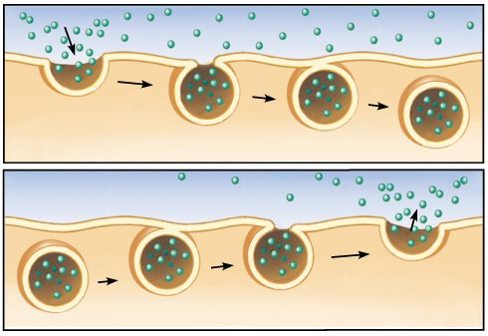
Vesicles = Endo and Exocytosis
Vesicle – a small package made out of the same lipid bilayer material of the cell membrane
Require energy to form!
Endocytosis = moving substances into the cell
Exocytosis = moving substances out of the cell

Slide 18
